Slide 1
Audio Signal Processing
With Python

Slide 2
Require these module
import sounddevice as sd
import soundfile as sf
from scipy.io.wavfile import write
import matplotlib.pyplot as plt
import numpy as np

Slide 3
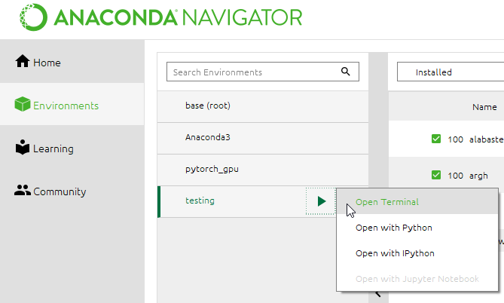
You can use the base environment too

Slide 4
Do pip install

Slide 5
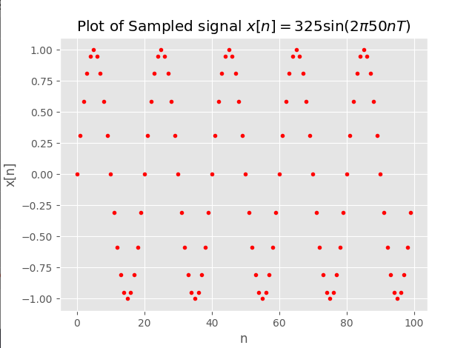
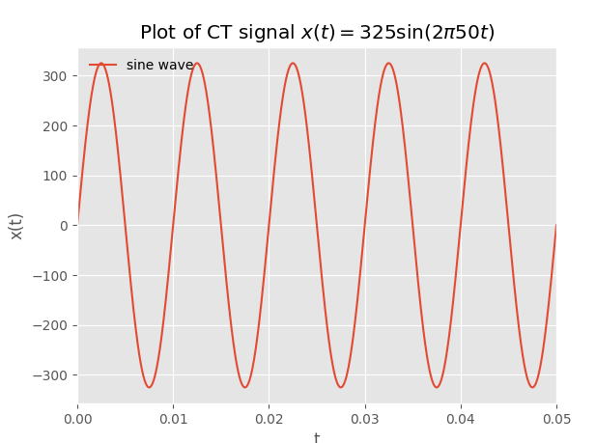
Plotting signal in time domain
script_01_plot_signal.py

Slide 6
Sound analysis
Purpose is to experiment with simple technique to detect the presence of voice in a quiet enviornment
script_02_run_sound_analysis_in_time_domain.py

Slide 7
Do audio recording
Record your own voice saying 4-5 words
#%% Do audio recording
# Parameter
filename = 'output.wav'
fs = 44100 # Sample rate
seconds = 3 # Duration of recording
myrecording = sd.rec(int(seconds * fs), samplerate=fs, channels=2)
sd.wait() # Wait until recording is finished
write(filename, fs, myrecording) # Save as WAV file

Slide 8
Sound playback
#%% Playback the recorded sound
filename = 'output.wav'
# Extract data and sampling rate from file
data, fs = sf.read(filename, dtype='float32')
sd.play(data, fs)
status = sd.wait() # Wait until file is done playing

Slide 9
#%% Display the recorded sound waveform (plot signal in time domain)
plt.figure(1)
sig1 = myrecording[:,1] # pick channel 1 of stereo audio stream
plt.plot(sig1)
print(" Total samples for {} secs recorded sound = {} ".format(seconds,len(sig1)))
# Show time in secs for x axis
T = 1/fs # sampling period
tvec = T * np.arange(len(sig1))
plt.figure(2)
plt.plot(tvec,sig1)
stringt = "Recorded sound of {} secs".format(seconds)
plt.title(stringt)
plt.show()

Slide 10
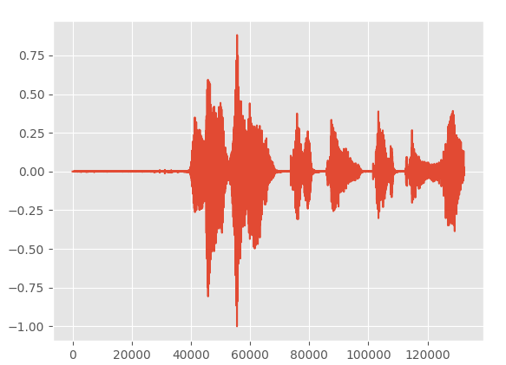
A waveform with with integer indexs (sample number)

Slide 11
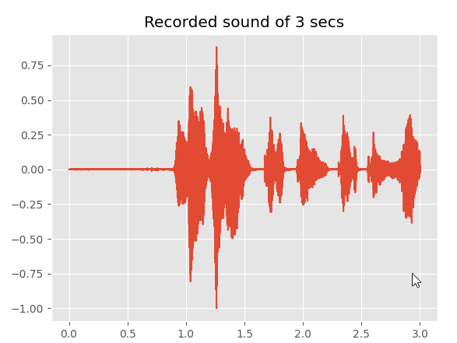
Hear my recorded sound hello, hello, testing testing
X axis in time

Slide 12
Play selected segment
#%% Plot only selected sound segment
t_start = 1.0
t_end = 3 # sec
n1 = int( np.floor(t_start/T) )
n2 = int( np.floor(t_end/T) )
sig1_sel = sig1[n1:n2+1] # include n2
numPt = len(sig1_sel)
tvec = T * np.arange(n1,n1+numPt)
plt.figure(3)
plt.plot(tvec,sig1_sel)
stringt = "Recorded sound of {} secs to {} secs".format(t_start, t_end)
plt.title(stringt)
plt.show()
# Play only selected segment
sd.play(sig1_sel, fs)
status = sd.wait() # Wait until file is done playing

Slide 13
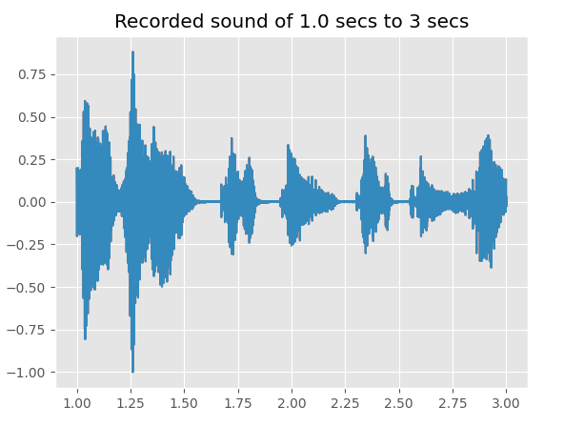

Slide 14
Challenge exercise for students
Design a voice activity detector
Write a program to monitor the sound of a quite room during an online test
Print out an alert when a sound of somebody speaking is detected

